Slide 1

Automotive Technology:
A Systems Approach, 8e
Chapter 10: Engine Disassembly and Cleaning
Rob Thompson and Jack Erjavec, Automotive Technology: A Systems Approach, 8th Edition. © 2025 Cengage. All Rights Reserved. May not be scanned, copied or duplicated, or posted to a publicly accessible website, in whole or in part.

Slide 2
Chapter Objectives (1 of 2)
10.01 Prepare an engine for removal.
10.02 Remove an engine from a FWD and a RWD vehicle.
10.03 Separate the engine into its basic components.
10.04 Clean engine parts using the appropriate method for the construction of the part.

Slide 3
Chapter Objectives (2 of 2)
10.05 Inspect engine parts for cracks.
10.06 Perform common services to an engine while it is in a vehicle.
10.07 Remove and reinstall a cylinder head.

Slide 4
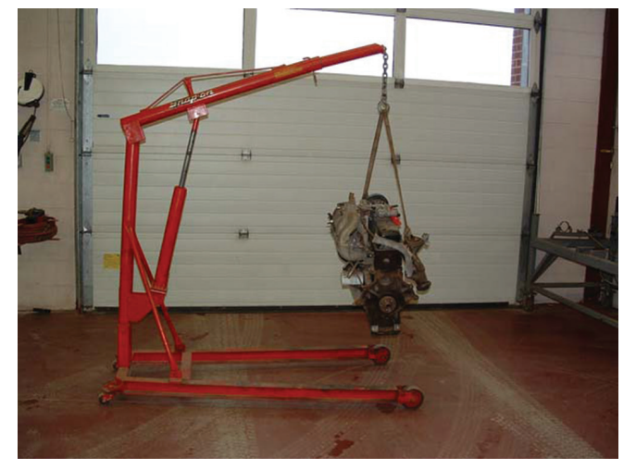
Removing an Engine (1 of 7)
10.01 Prepare an engine for removal.
Make sure you have the tools and equipment required for the job.
You will also need an engine hoist or crane and a jack.
The procedures for engine removal vary.
  Depending on whether the engine is removed from the bottom of the vehicle or through the hood opening.

Slide 5
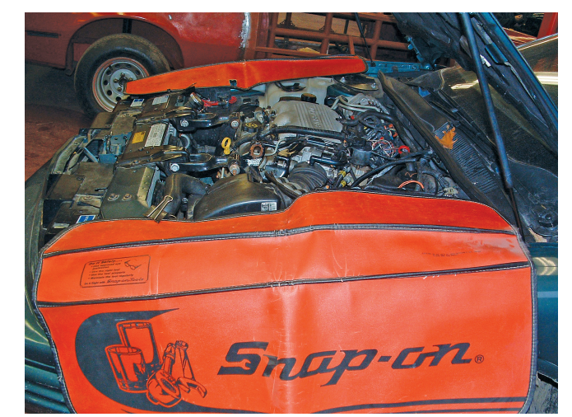
Removing an Engine (2 of 7)
When removing an engine, open the hood and put fender covers on both front fenders.
Once the vehicle is in position, relieve the pressure in the fuel system using the procedures given by the manufacturer.
Install a memory saver before you disconnect the battery to prevent the vehicle’s computers and other devices from losing what they have stored in their memory.
Disconnect all negative battery cables and place them away from the battery.
If the battery will be in the way of engine removal, remove the positive cables and the battery.
If the vehicle is a hybrid, you will need to disconnect the high-voltage wiring.

Slide 6
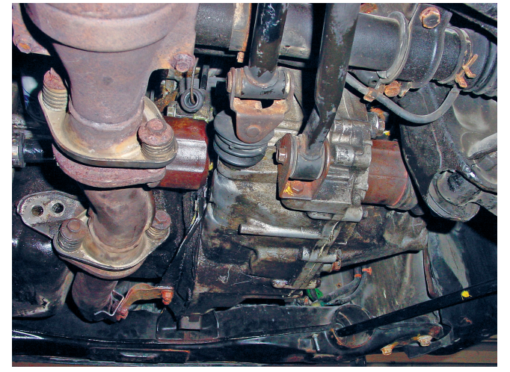
Removing an Engine (3 of 7)
Underbody Connections
  While you are under the vehicle to drain the fluids, disconnect the shift linkage, transmission cooling lines, all electrical connections, vacuum hoses, and clutch linkages from the transmission.
  If the clutch is hydraulically operated, unbolt the slave cylinder and set it aside, if possible.
  If this is not possible, disconnect and plug the line into the cylinder.

Slide 7
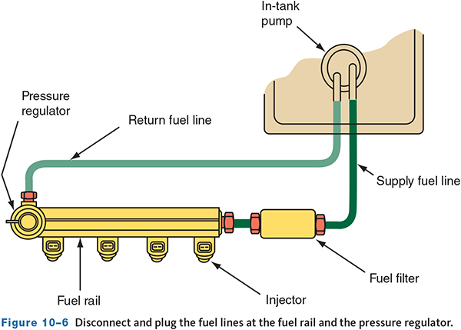
Removing an Engine (4 of 7)
Remove the air intake ducts and air cleaner assembly.
Depressurize the fuel system if possible. This is especially important for engines with direct fuel injection.
Disconnect and plug the fuel line at the fuel rail.
Make sure all fuel lines are closed off with pinch pliers or an appropriate plug or cap.
Most late-model fuel lines have quick-connect fittings that are separated by squeezing the retainer tabs together and pulling the fitting off the fuel line nipple.
Disconnect all vacuum lines at the engine.

Slide 8
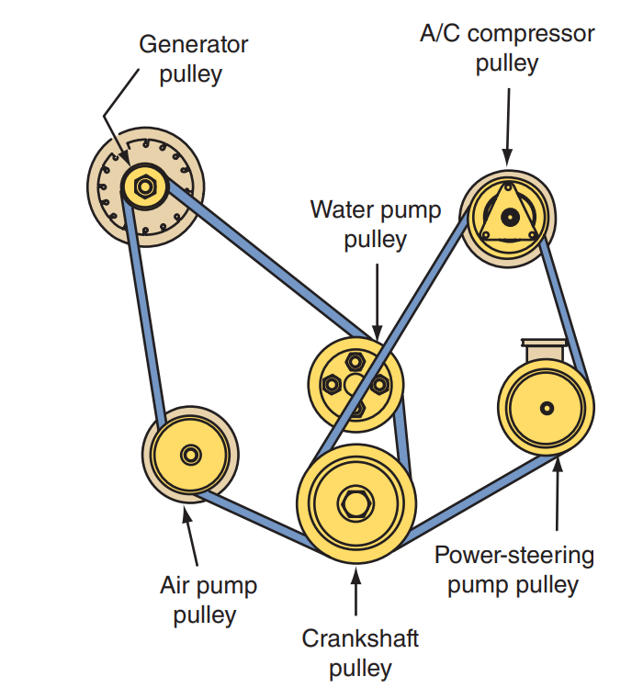
Removing an Engine (5 of 7)
Accessories
  Remove all drive belts.
  Unbolt and move the power-steering pump and air-conditioning (A/C) compressor out of the way.
  Don’t disconnect the lines unless necessary.
  If the pressure hoses at the A/C compressor must be disconnected, do not loosen the fittings until the refrigerant has been captured by a refrigerant reclaimer/recycling machine.

Slide 9
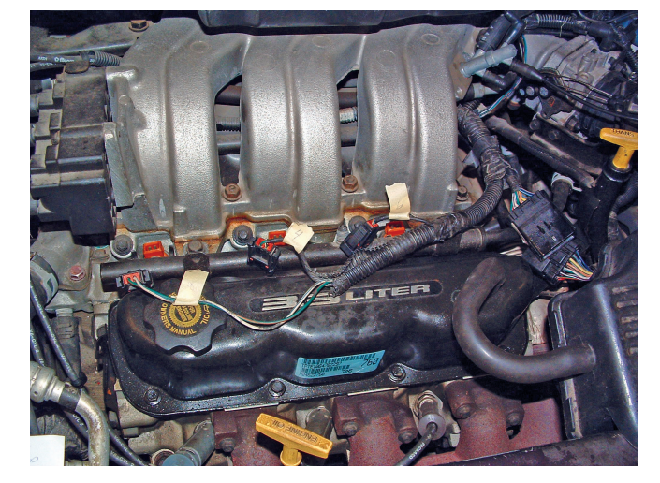
Removing an Engine (6 of 7)
Electrical Connections
  Unplug all electrical connectors between the engine and the vehicle.
  Use masking tape to label all wires that are disconnected.
  Most engines have a crankshaft position sensor attached above the flywheel or flexplate.
  This sensor must be removed before separating the engine from the bell housing.

Slide 10
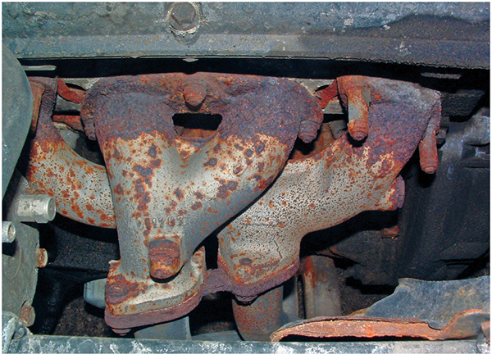
Removing an Engine (7 of 7)
Disconnect the exhaust system; try to do this at the exhaust manifold.
When disconnecting the exhaust system, make sure the wires connected to the exhaust sensors are disconnected before the system is moved.
Remove any heat shields that may be in the way of moving or removing the exhaust system.
Because there is typically easy access to the cables, wiring, and bell housing bolts, removing the engine from a RWD vehicle is more straightforward than removing one from a FWD model.
Engines in FWD cars can be more difficult to remove because large assemblies such as engine cradles, suspension components, brake components, splash shields, or other pieces may need to be disassembled or removed.

Slide 11
Discussion
When performing engine service, a lot of parts have to be removed, and often for a long time. The reassembly may not occur for days, weeks, months, or longer.
Have a class discussion about what you will do to be sure you are able to reassemble everything correctly, not lose parts and hardware, and organize your space.

Slide 12
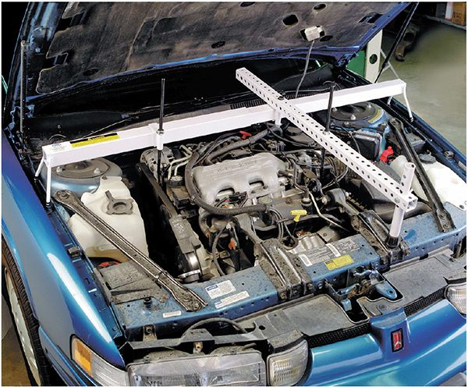
FWD Vehicles (1 of 4)
10.02 Remove an engine from a FWD and a RWD vehicle.
Most often the engine and powertrain in a FWD vehicle are removed through the bottom of the vehicle.
Special tools may be required to hold the transaxle and/or engine in place as it is being disconnected from the vehicle.
Always refer to the service information before proceeding to remove the transaxle.

Slide 13
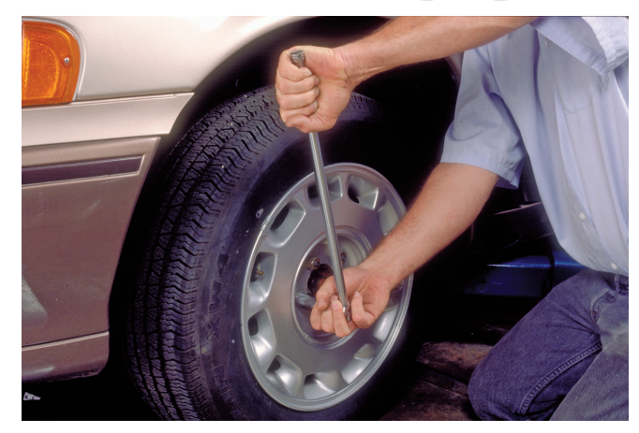
FWD Vehicles (2 of 4)
Using a large breaker bar, loosen and remove the axle shaft hub nuts.
It is recommended that these nuts be loosened with the vehicle on the floor and the brakes applied.
Tap the splined CV joint shaft with a soft-faced hammer to loosen it. Most will come loose with a few taps.
Disconnect all suspension and steering parts that need to be removed according to the service information.
Pull the drive axles from the transaxle. While removing the axles, make sure the brake lines and hoses are not stressed.

Slide 14
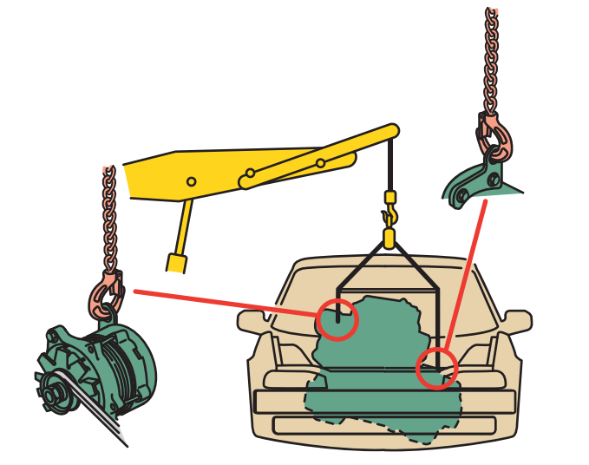
FWD Vehicles (3 of 4)
Removing the engine through the hood opening:
Connect the engine sling or lifting chains to the engine.
Use the lifting hooks on the engine or fasten the sling to the points given in the service information.
From under the vehicle, remove the cross member and remove the mounting bolts at the engine and transaxle mounts.
With a transmission jack supporting the transmission, remove the transaxle mounts.
From under the hood, remove all remaining mounts.
Then slowly raise the engine from the engine compartment.

Slide 15
FWD Vehicles (4 of 4)
Removing the engine from under the Vehicle:
Position the engine cradle and dolly under the engine.
Adjust the pegs of the cradle so that they fit into the recesses on the bottom of the engine, and secure the engine.
Remove all engine and transaxle mount bolts. If required, remove the frame member from the vehicle. It may also be necessary to disconnect the steering gear from the frame.
Slowly raise the vehicle, lifting it slightly away from the engine.
As the vehicle is lifted, the engine remains on the cradle. During this process, continually check for interference with the engine and the vehicle.
Also, watch for any wires and hoses that may still be attached to the engine. Once the vehicle is clear of the engine, prepare to separate the engine from the transaxle.

Slide 16
RWD Vehicles (1 of 2)
The engine is removed through the hood opening with an engine hoist on most RWD vehicles.
Refer to the service information to determine the proper engine lift points.
Attach a pulling sling or chain to the engine.
Some engines have eye plates for lifting.
If they are not available, the sling must be bolted to the engine.
The attaching bolts for the sling must be strong enough to support the engine and must thread into the block a minimum of 1½ times the bolt diameter.
If the transmission is being removed with the engine, position the hook of the engine hoist to the lifting chain so that the engine tips a little toward the transmission.
Lift the engine slightly and check for any additional things behind and under the engine that should be disconnected.

Slide 17
RWD Vehicles (2 of 2)
If the engine and transmission must be separated before engine removal, remove all clutch (bell) housing bolts.
If the vehicle has an automatic transmission, remove the torque converter mounting bolts.
If the transmission is being removed with the engine it may need to be drained.
Remove the drive shaft, disconnect all electrical connections and the speedometer cable, if so equipped, at the transmission.
Make sure you place these away from the transmission so that they are not damaged during transmission removal or installation. Disconnect and remove the transmission and clutch hydraulic lines or linkage.
Disconnect the parts of the exhaust system that may get in the way.
Use a transmission jack to securely support the transmission and unbolt the engine mounts.

Slide 18
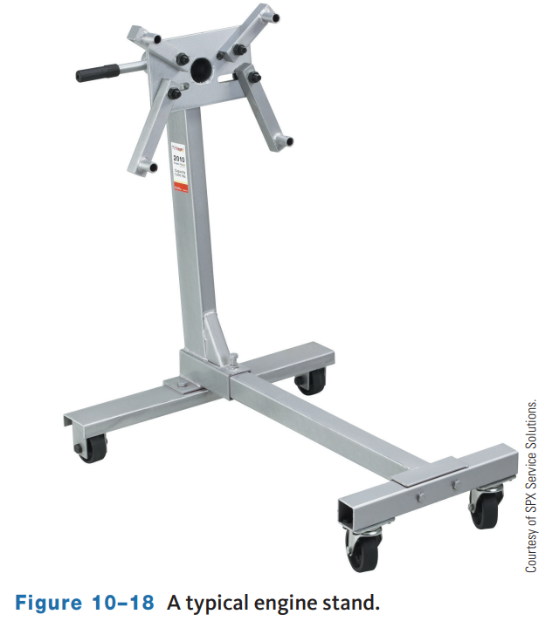
Engine Disassembly and Inspection (1 of 2)
Raise the engine and position it next to an engine stand.
In most cases, the flywheel or flexplate must be removed to mount the engine on its stand.
Mount the engine to the stand. Most stands use a plate with several holes or adjustable arms.
The engine must be supported by at least four bolts that fit solidly into it. The engine should be positioned so that its center is in the middle of the engine stand’s adapter plate.
Once the engine is securely mounted to the engine stand, remove the sling or lifting chain.
The engine can now be disassembled and cleaned.
Always refer to the service information before you start to disassemble an engine.

Slide 19
Engine Disassembly and Inspection (2 of 2)
Note that intake manifold bolts often need to be removed in reverse torque sequence to prevent warping of the manifold.
Check the rocker area for sludge. Excessive buildup can indicate a poor maintenance schedule and is a signal to look for wear on other components.
If possible, rotate the crankshaft to check the alignment of the sprockets. The valves will hit the pistons on some engines when the timing belt or chain slips, skips, or breaks. These engines are commonly called interference engines. When the valves hit the piston, they will bend.
The valves in freewheeling engines will not hit the piston when valve timing is off.
The cylinder head bolts are loosened one or two turns each, following the pattern specified by the manufacturer. The sequence is typically the opposite of the tightening sequence.

Slide 20
Cleaning Engine Parts (1 of 2)
10.04 Clean engine parts using the appropriate method for the construction of the part.
Being able to recognize the type of dirt you are to clean will save you time and effort. There are four types of dirt:
  Water-Soluble Soils The easiest dirt to clean is water-soluble soils, meaning those that will dissolve in water, which includes dirt, dust, and mud.
  Organic Soils which contain carbon and cannot be effectively removed with plain water. There are three distinct groupings of organic soils:
  Petroleum by-products derived from crude oil, including tar, road oil, engine oil, gasoline, diesel fuel, grease, and engine oil additives.
    By-products of combustion, including carbon, varnish, gum, and sludge.
    Coatings, including such items as rust-proofing materials, gasket sealers and cements, paints, waxes, and sound-deadener coatings.

Slide 21
Cleaning Engine Parts (2 of 2)
Rust is the result of a chemical reaction that takes place when iron and steel are exposed to oxygen and moisture.
Corrosion, like rust, results from a similar chemical reaction between oxygen and metal containing aluminum.
If left unchecked, both rust and corrosion can physically destroy metal parts. In addition to metal destruction, rust also acts to insulate and prevent proper heat transfer inside the cooling system.
Scale: When water containing mineral deposits is heated, suspended minerals and impurities tend to dissolve, settle out, and attach to the surrounding hot metal surfaces.
This buildup inside the cooling system is known as scale. Over time, scale can accumulate to the extent that passages become blocked, cooling efficiency is compromised, and metal parts start to deteriorate.

Slide 22
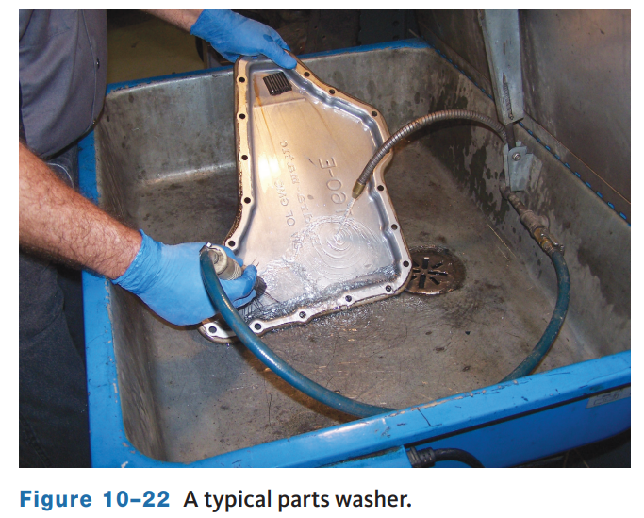
Chemical Cleaning Machines (1 of 2)
Parts Washers
  Parts washers (often called solvent tanks) are one of the most widely used and inexpensive methods of removing grease, oil, and dirt from metal surfaces.
  A typical parts washer has a tank that holds the solvent and some method of applying the solvent.
  These methods include soaking, soaking and agitation, solvent streams, and spray gun applicators.

Slide 23
Chemical Cleaning Machines (2 of 2)
There are two types of soak tanks:
  Cold soak tanks are commonly used to clean carburetors, throttle bodies, and aluminum parts.
    A typical cold soak unit has a basket to hold the parts to be cleaned. After soaking with or without gentle agitation is complete, the parts are removed, flushed with water, and blown dry with compressed air.
    Cleaning time is short, about 20 to 30 minutes.
    Agitation by raising and lowering the basket will reduce the soak period.
  Hot soak tanks are actually heated cold tanks.
    The source of heat is electricity, natural gas, or propane.
    The solution inside the hot tanks usually ranges from 160 °F to 200 °F.
    Most tanks are generally large enough to hold an entire engine block and its related parts. Hot tanks use a simple immersion process that relies on a heated chemical to lift the grease and grime off the surface.
    Agitation may also be used to speed up the job.

Slide 24
Thermal Cleaning
Thermal cleaning relies on heat to bake off or oxidize dirt and other contaminants.
Thermal cleaning ovens especially the pyrolytic type, have become increasingly popular.
The main advantage of thermal cleaning is a total reduction of all oils and grease on and in blocks, heads, and other parts.
The high temperature inside the oven (generally 650°F to 800°F) oxidizes the grease and oil, leaving behind a dry, powdery ash on the parts.
The ash must then be removed by shot blasting or washing.
One of the major attractions of cleaning ovens is that they offer a more environmentally acceptable process than chemical cleaning.
But although there is no solvent or sludge to worry about with an oven, the ash residue that comes off the cleaned parts must still be handled according to local disposal regulations.

Slide 25
Abrasive Cleaners (1 of 3)
Another way to clean parts involves the use of abrasives. Most abrasive cleaning machines are used in conjunction with other cleaning processes rather than as a primary cleaning process itself.
Some manual cleaning is inevitable. Heavy buildups of grease and/or carbon should initially be removed by scraping or wire brushing.
Cleaning aluminum and other soft metals with either technique should be done with extreme care, especially while using a steel scraper or brush.
Scrapers are used to remove old gasket material and heavy sludge.
Power tools with a small sanding disc (normally emery cloth) are available. These are designed to remove all soft materials without damaging the hard metal surface.
After the item has been scraped, an additional cleaning method is used to finalize cleaning.
Carbon can be removed with a handheld wire brush or a wire wheel driven by an electric or air drill motor.

Slide 26
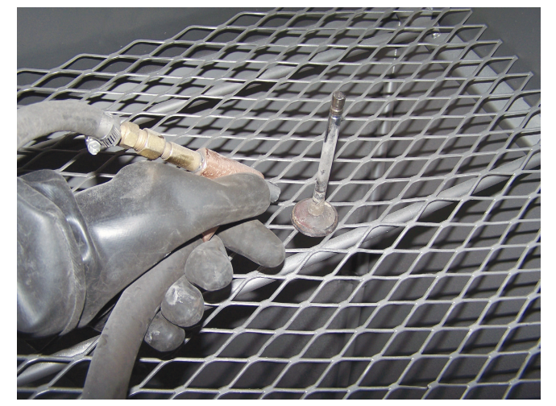
Abrasive Cleaners (2 of 3)
An abrasive blaster is another cleaning option.
Compressed air shot and grit blasters are best used on parts that will be machined after they have been cleaned.
Two basic types of media are available: shot and grit. Shot is round; grit is angular in shape.
Parts must be dry and grease free when they go into an abrasive blast machine. Otherwise, the shot or beads will stick.

Slide 27
Abrasive Cleaners (3 of 3)
Parts Tumbler
  A cleaning alternative that can save considerable labor when cleaning small parts such as engine valves is a tumbler.
Vibratory Cleaning
  Shakers, as they are frequently called, use a vibrating tub filled with ceramic, steel, porcelain, or aluminum abrasive to scrub parts.
  Most shakers have a tub filled with solvent to help loosen and flush away the dirt and grime.
  The solvent drains out the bottom and is filtered to remove the sludge.

Slide 28
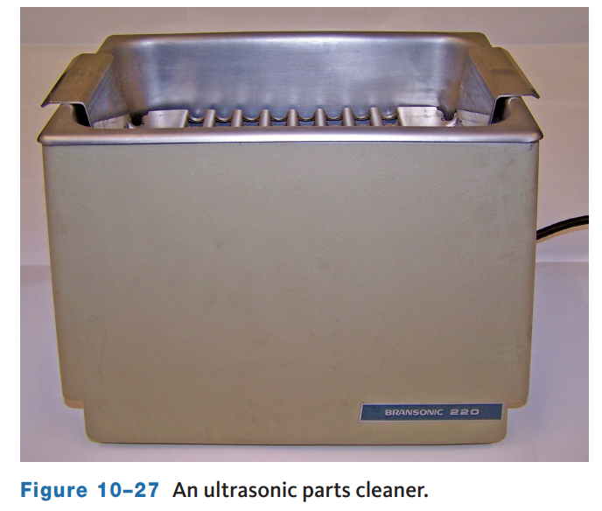
Alternative Cleaning Methods (1 of 2)
Ultrasonic Cleaning
  Ultrasonic cleaning utilizes high-frequency sound waves to create microscopic bubbles that burst into energy to loosen soil from parts.
  Because the tiny bubbles do all the work, the chemical content of the cleaning solution is minimized, making waste disposal less of a problem.
  The initial cost and handling capacity of ultrasonic equipment is its major disadvantage.

Slide 29
Alternative Cleaning Methods (2 of 2)
Citrus Chemicals
  Some chemical producers have citrus-based cleaning chemicals available to serve as a replacement for hazardous solvents and alkaline-based chemicals. Because of their citrus origin, these chemicals are safer to handle, easier to dispose of, and even smell good.
Salt Bath
  The salt bath is a unique process that uses high-temperature molten salt to dissolve organic materials, including carbon, grease, oil, dirt, paint, and some gaskets. For cast iron and steel, the salt bath operates at about 700 °F to 850 °F. For aluminum or combinations of aluminum and iron, a different salt solution is used at a lower temperature (about 600 °F). The contaminants precipitate out of the solution and sink to the bottom of the tank, where they must be removed periodically

Slide 30
Knowledge Check (1 of 2)
  True or False? Parts washers are one of the most widely used and inexpensive methods of removing grease, oil, and dirt from metal surfaces.

Slide 31
Knowledge Check Answer (1 of 2)
  Answer: True. Parts washers are one of the most widely used and inexpensive methods of removing grease, oil, and dirt from metal surfaces.

Slide 32
Crack Detection (1 of 2)
10.05 Inspect engine parts for cracks.
Once engine parts have been cleaned, everything should be inspected.
This inspection should include a check for cracks, especially in the engine block and cylinder head.
If cracks in the metal casting are discovered during the inspection, they should be repaired or the part replaced
Cracks in metal castings are the result of stress or strain on a section of the casting.
  This stress finds a weak point in the casting and causes it to distort or separate at that point.
  These stresses have multiple causes such as:
    Pressure or temperature changes during the casting process.

Slide 33
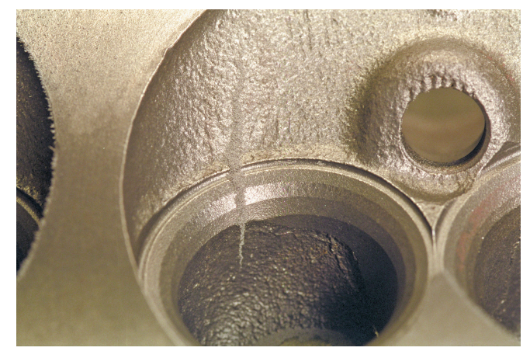
Crack Detection (2 of 2)
Cracks can be found by visual inspection; however, many are not easily seen. Therefore, engine rebuilders use special equipment to detect cracks, especially if there is reason to suspect a crack.
Pressure Checks
  Pressure checking a cylinder block or head is done in the same way as a tire is checked for leaks. The block or head is then submerged in water and air injected. Bubbles will form in the water if there is a leak. The spot where the bubbles are forming identifies the location of the leak.
Magnetic Checks
  Magnetic particle inspection (MPI) uses a permanent or electromagnet to create a magnetic field in a cast iron part. Iron filings are sprinkled on the surface to detect a secondary magnetic field resulting from a crack.

Slide 34
In-Vehicle Engine Service (1 of 2)
10.06 Perform common services to an engine while it is in a vehicle.
Some services on an engine can be performed with the engine still in a vehicle.
Many of the procedures for performing under-the-hood services involve the same steps as when the engine is removed.
Oil Pan Gasket
  Often a damaged oil pan gasket is the source of oil leaks.
  Replacing the gasket can be done with the engine in the vehicle.
  The procedure for doing this varies with the vehicle model, so always refer to the service information.
  The basic procedure is different for RWD and FWD vehicles.

Slide 35
In-Vehicle Engine Service (2 of 2)
Replacing an engine’s vibration (harmonic) damper can be a bit complex.
Longitudinal Engines: The following is a typical procedure for replacing a damper on an engine that is positioned longitudinally:
  Remove the drive belt and then hold the crankshaft pulley and remove the bolt in the center of the pulley. When the bolt is removed, the pulley may easily pull off with its washer.
  If the pulley does not easily pull off, you will need to use a crankshaft pulley puller. Depending on the engine, a steering wheel puller may be used or a special puller may be required.
  The new bolt should be coated with engine oil before it is installed. Install the new pulley onto the crankshaft.
  This is typically a torque to-yield bolt. So, make sure it is tightened to specifications and further tightened to the specified angle.

Slide 36
Cylinder Head (1 of 4)
10.07 Remove and reinstall a cylinder head.
Removing a cylinder head on an engine that is still in the vehicle follows many of the same steps as removing it when the engine is on an engine stand.
The exact procedure varies with the vehicle and the type of engine. Below is an example of performing this service on a late-model V engine and an in-line engine.
These procedures include the removal and installation of many parts that may require service without the need for removing the head.
Before beginning, connect a scan tool to the data link connecter (DLC), and check the engine’s coolant temperature. Wait until the temperature is below 100 °F (38 °C) before proceeding.
This is done to prevent damage to the intake manifold and cylinder head(s). Once the temperature is acceptable, remove the intake manifold.

Slide 37
Cylinder Head (2 of 4)
Preparing for removal on all engines has common steps, but some steps will vary depending on model and engine type.
Drain the engine’s oil.
Remove the cylinder block drain plugs and drain the coolant.
Reinstall the cylinder block drain plugs.
Disconnect the battery ground cable; wait at least 3 minutes before beginning work.
Mark all electrical connectors and wire harness clamps, so you know their original location and disconnect them from the intake manifold and cylinder head.
Remove the ignition coil assemblies.
Relieve the fuel pressure at the fuel rail and disconnect the fuel supply hose. Disconnect the fuel feed hose and remove the fuel rail.

Slide 38
Cylinder Head (3 of 4)
Some V-type engines have an upper and lower intake manifold, and these are serviced individually.
Remove the bolts that retain the upper manifold and then pull it away from the engine. Then, unbolt the lower intake manifold and remove its gasket and front and rear seals.
Remove the exhaust manifold from the cylinder head you are servicing. For some OHC engines, the camshaft roller followers should be removed next.
Make sure to label the location of each follower so that they can be installed in their original location.
On OHV engines, loosen the rocker arms and remove the push rods. Keep the push rods in order so that they are reinstalled correctly.
Rotate the crankshaft until the timing marks on the camshaft sprockets are at the specified position.
Now remove the timing chain or belt tensioning system from the timing chains or belts. Remove the timing chains or belts. Remove the cylinder head bolts according to the specified order. Then, pull off the cylinder head.

Slide 39
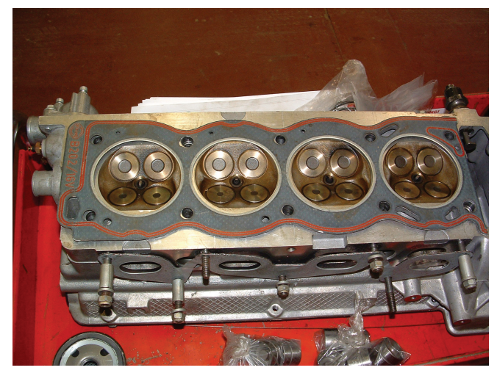
Cylinder Head (4 of 4)
Installation for All Engines
  Clean the cylinder head-to-block mating surfaces.
  Use a plastic scraper to remove silicone or gasket material.
  Use a straightedge and feeler gauge set to check the flatness of the sealing surfaces of the cylinder head and block.
  Place the new head gasket(s) over the locating dowels in the block or cylinder head.
  Then, lower the cylinder head in place.

Slide 40
Knowledge Check (2 of 2)
When removing camshaft followers or valvetrain parts, why should the technician make sure to label the location of each follower?

Slide 41
Knowledge Check Answer (2 of 2)
Make sure to label the location of each follower so that they can be installed in their original location.

Slide 42
Chapter Reflection
Please take a moment to compare your perception of the automotive industry before and after you studied this chapter. Then respond to the following questions in one or two paragraphs. Use 150–200 words in your reflection.
Did anything in this chapter change your thinking about engine disassembly and cleaning?
Considering all you have learned, what techniques or procedures would you put into place when performing this type of work in the shop?

